Slide 1


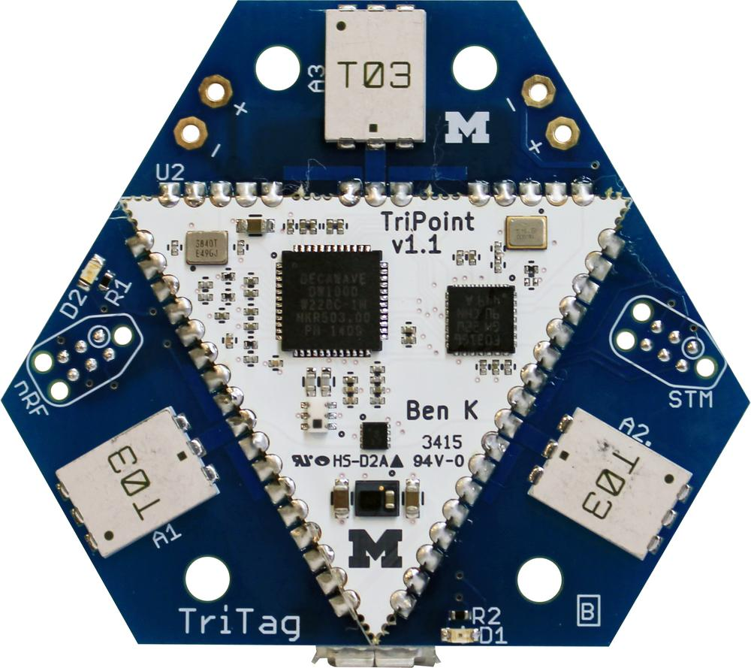
PolyPoint and the First Steps Towards Ubiquitous Localization
Pat Pannuto
In collaboration with Benjamin Kempke, Bradford Campbell,
Ye-Sheng Kuo, William Huang, Joshua Adkins, and Prabal Dutta
Student Summit on Mobility, Systems, and Networking
February 1-2, 2016, Petaluma, California, USA
Notes:
[as submitted in advance]:
Title: PolyPoint and the First Steps Towards Ubiquitous Location
Abstract: In the not too distant future, location will be a fundamental primitive available to all devices, akin to a unique id, a sense of time, and basic communication. This talk briefly articulates why location is a natural and inevitable primitive, explores the definition of a location, and considers the state and evolution of localization technology today. The talk then introduces the PolyPoint localization platform, an up-and-coming drop-in module that aims to provide high-fidelity indoor location information.

Slide 2
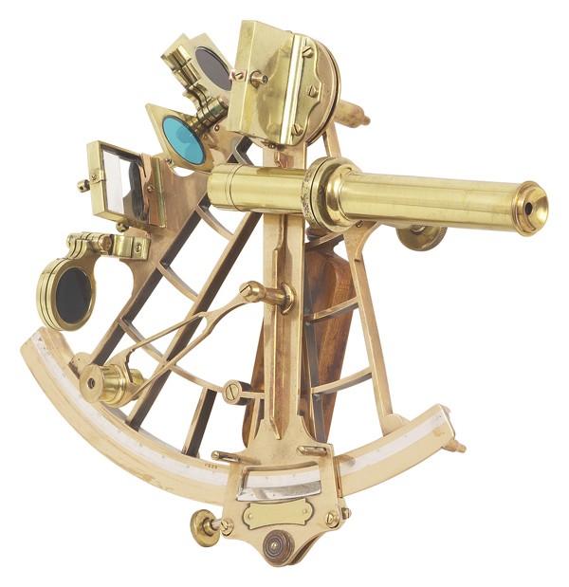
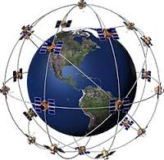
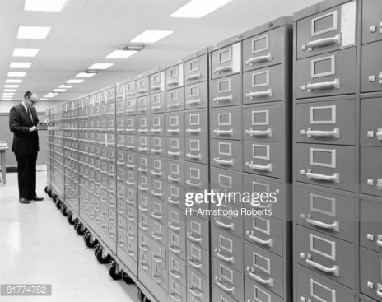

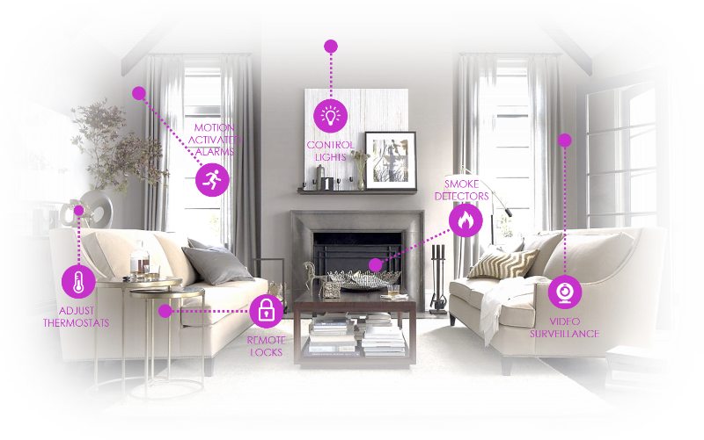
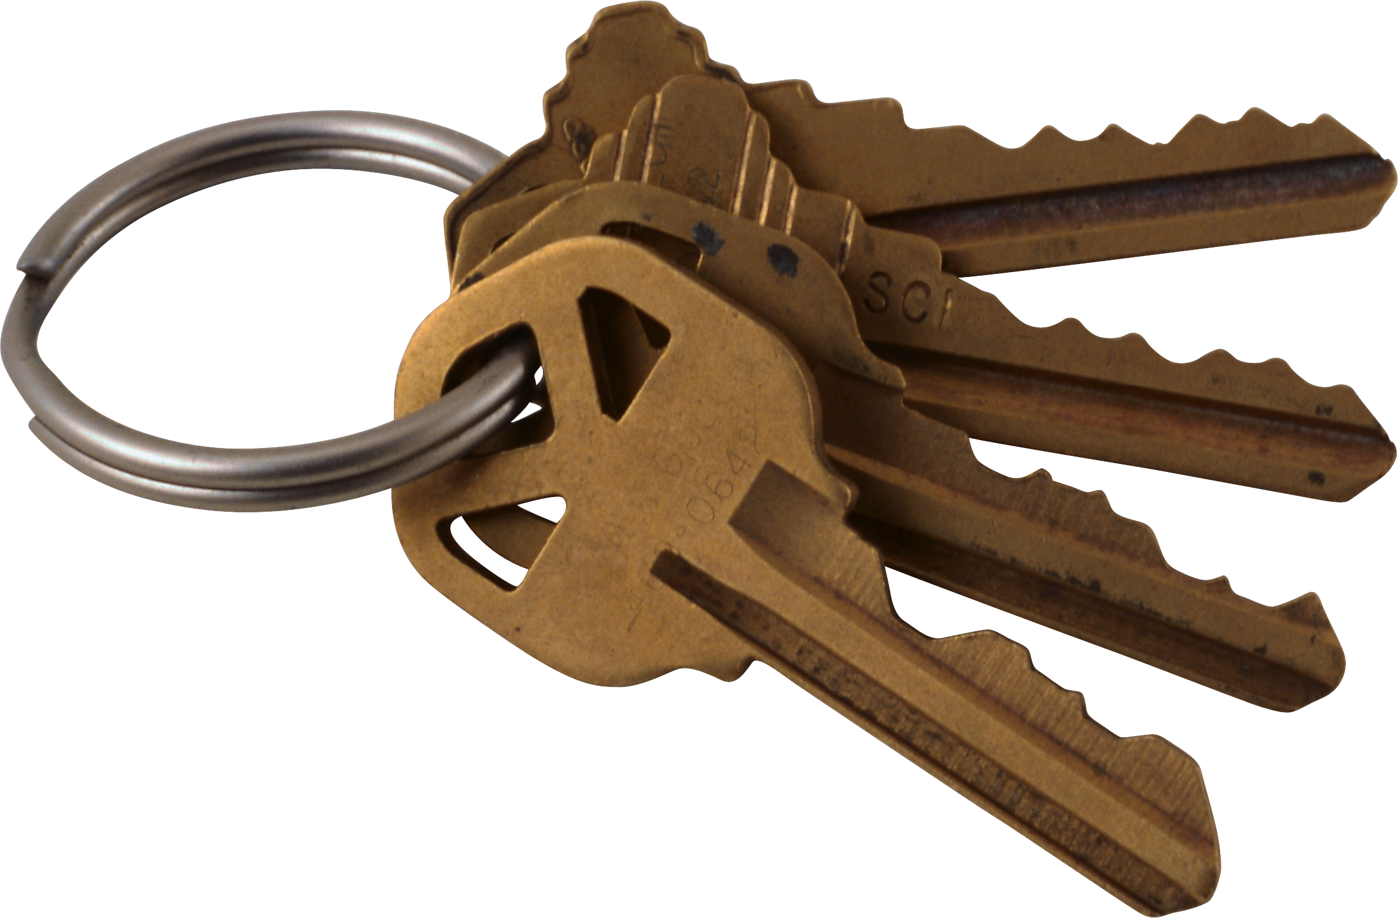
Localization technology is on the cusp of a new revolution
Reliable sea-faring invited the “Age of Discovery”
GPS built and reinvented industries
Digitization of information ushered in the “Information Age”
Search vs File
In the next 20 years, ubiquitous localization is nigh
Search vs File of physical things

Slide 3

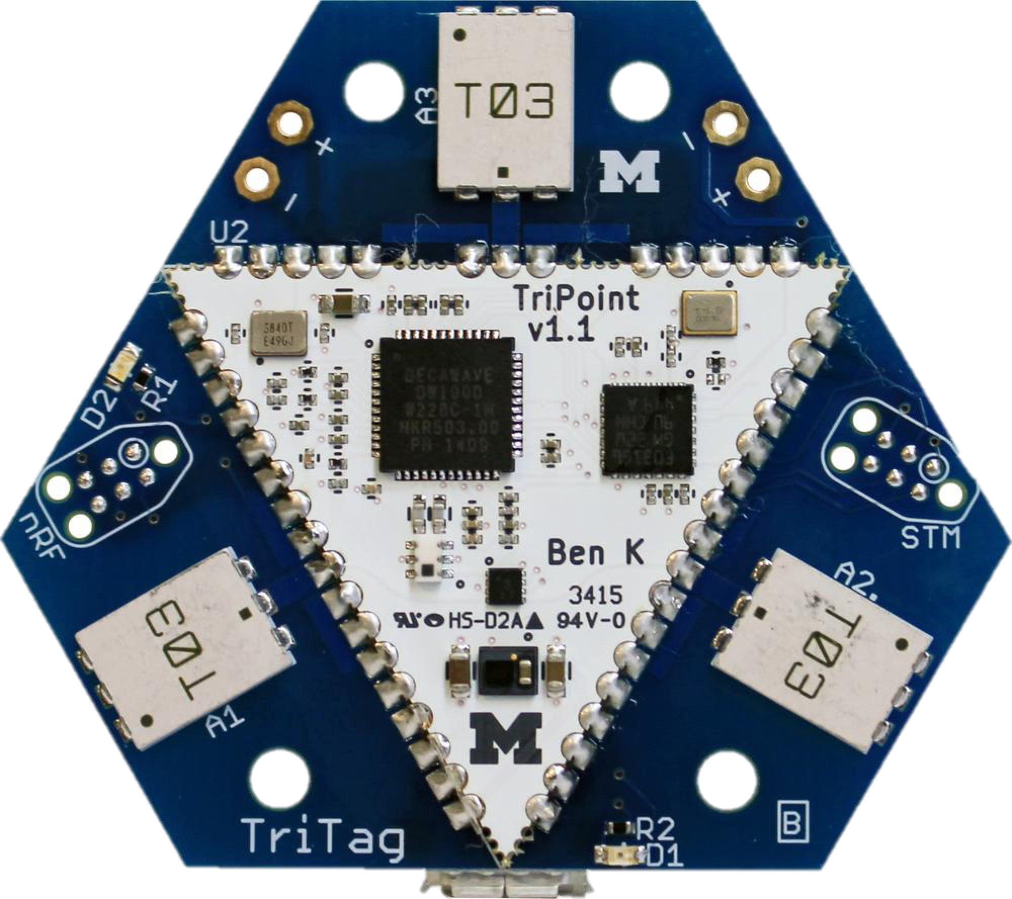
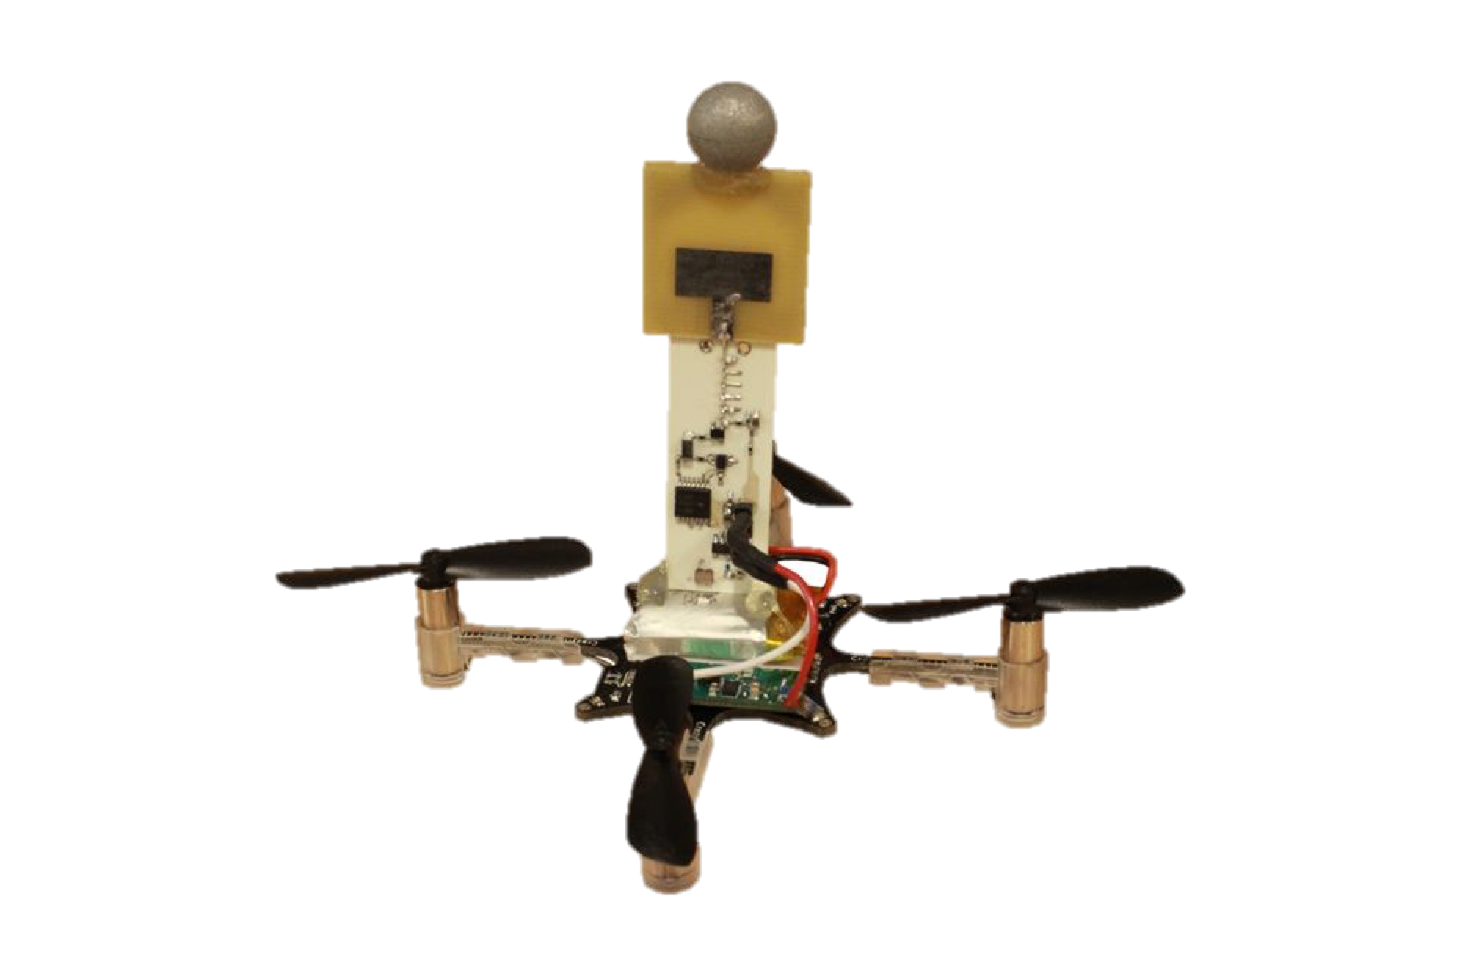
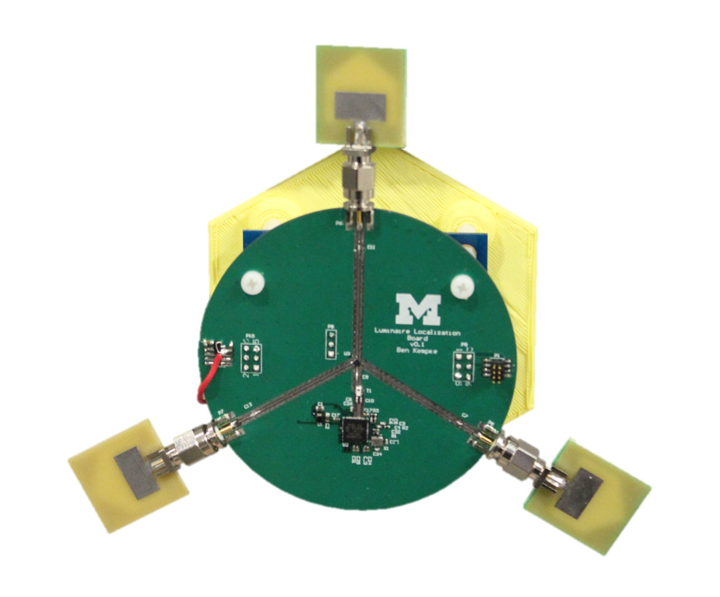
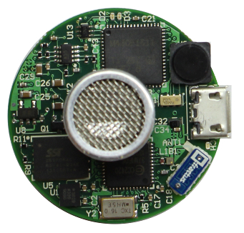
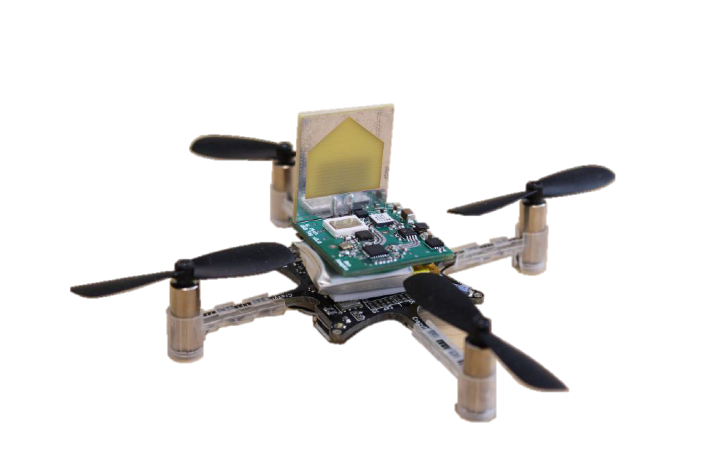
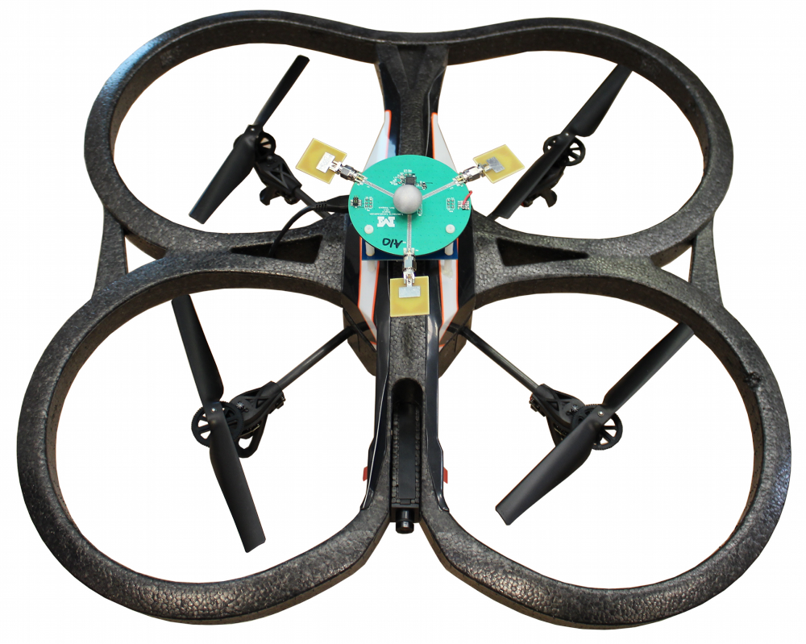
Localization technology is on the cusp of a new revolution
Reliable sea-faring invited the “Age of Discovery”
That we “solved” in the 1970s
That we are still solving today

Slide 4
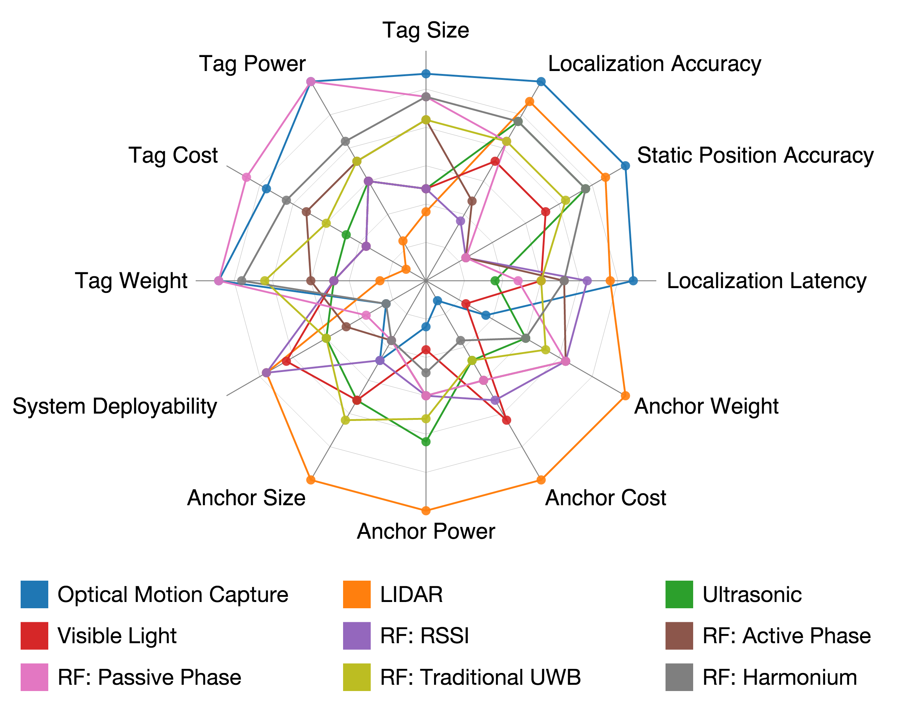
Localization technologies present an immense tradeoff space
Here are 12 dimensions
Covering 9 technologies
Each have several implementations
Is there a universal “right answer”?

Slide 5
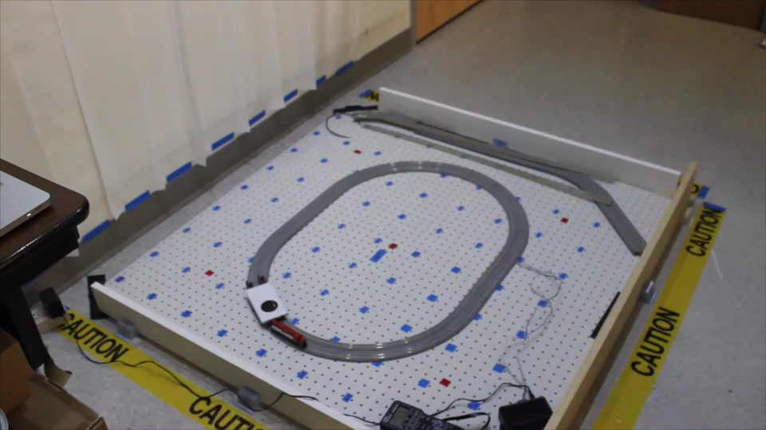
Luxapose: Astral navigation with smart phones and smart lights
Luxapose: Indoor Positioning with Mobile Phones and Visible Light (MobiCom’14)
Ye-Sheng Kuo, Pat Pannuto, Ko-Jen Hsiao, and Prabal Dutta

Slide 6
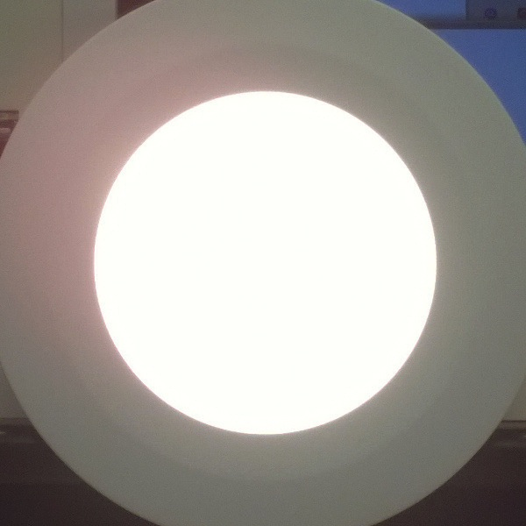
Luxapose enables high-fidelity indoor localization with impending infrastructure
Human Perception
Decimeter-level accuracy
Unmodified smartphones
Trivially modified LED lights
Camera Perception
Luxapose: Indoor Positioning with Mobile Phones and Visible Light (MobiCom’14)
Ye-Sheng Kuo, Pat Pannuto, Ko-Jen Hsiao, and Prabal Dutta

Slide 7
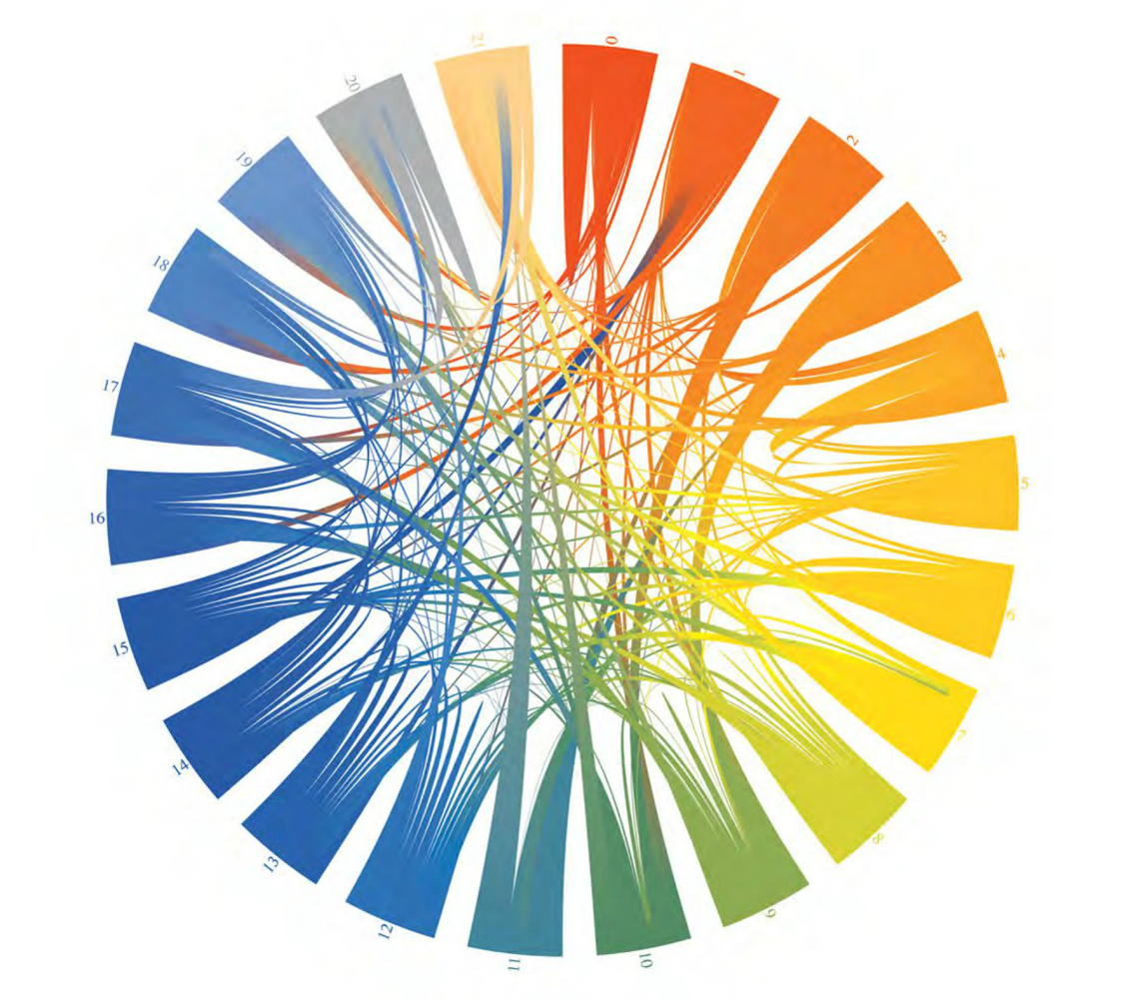
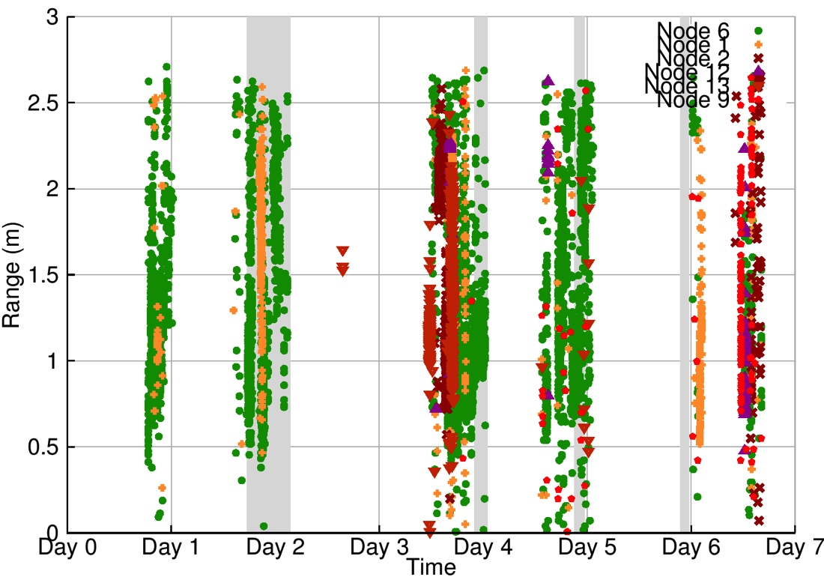
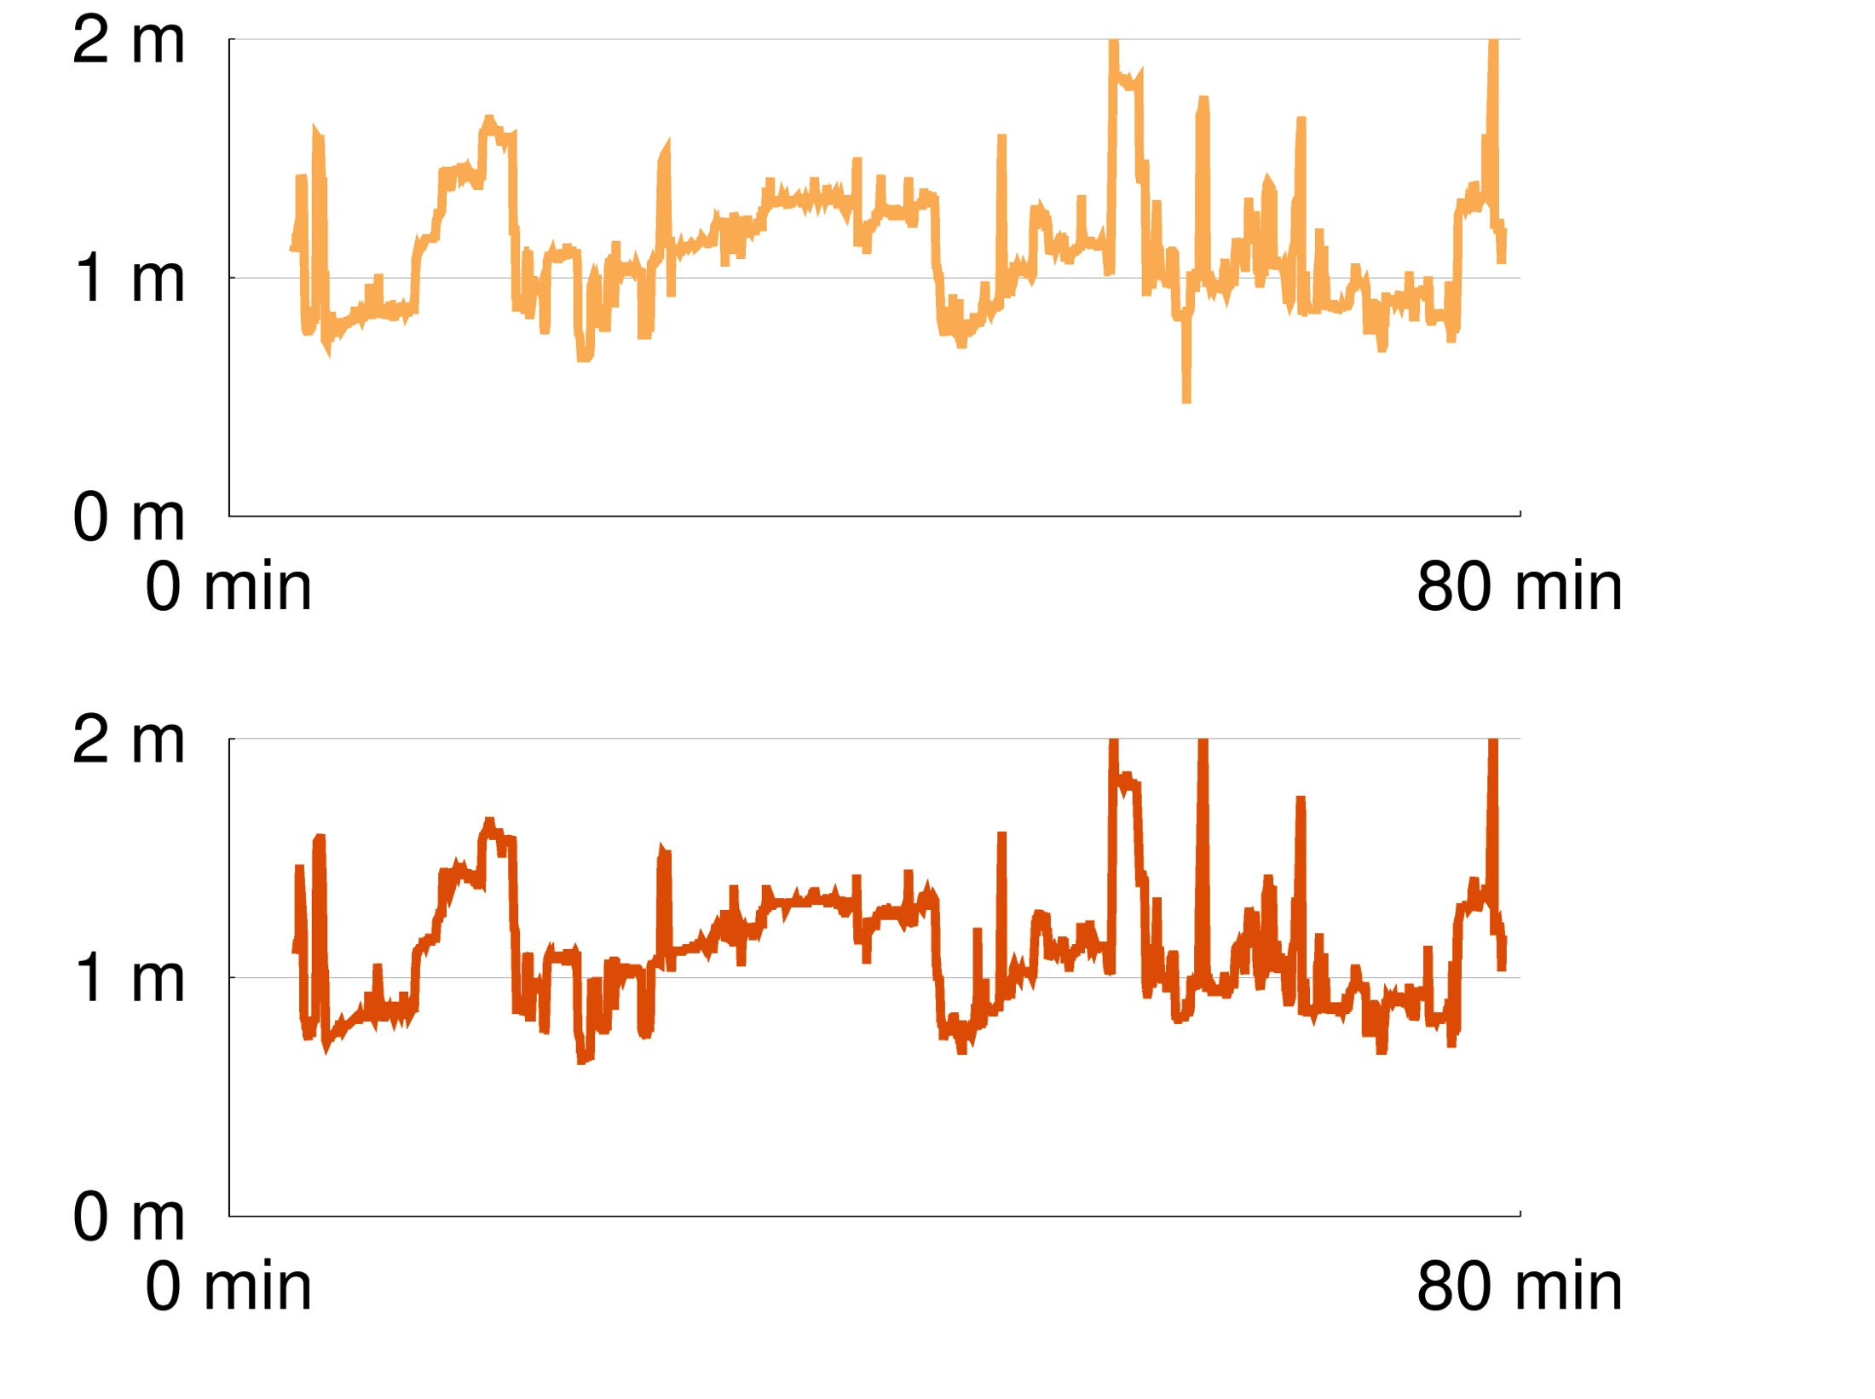
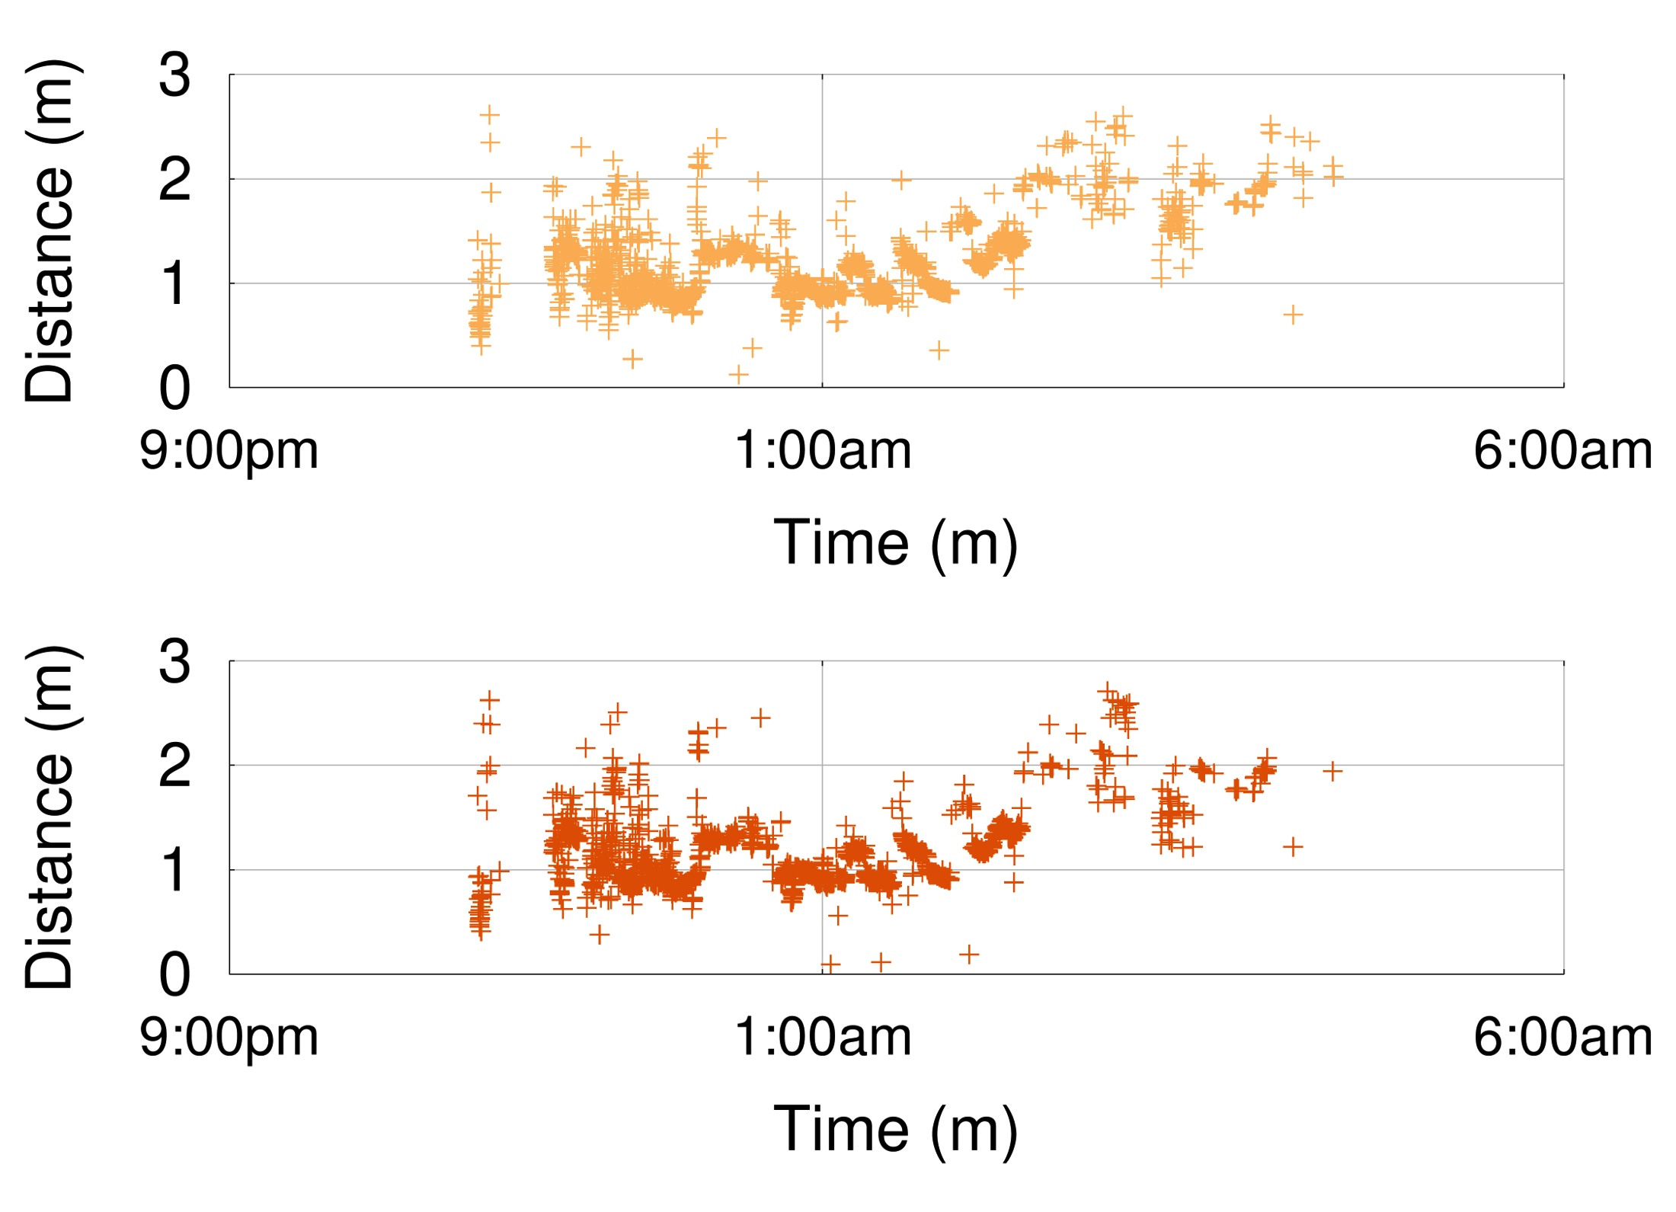
Opo: Forgoing absolute location for high fidelity relative location
Application
Human Interaction Tracking
Key Tradeoffs
Ranging Accuracy
Duration Accuracy
Usability
Opo
5 cm accuracy, 2 s minimum interaction, 93 hour battery life
Opo: A Wearable Sensor for Capturing High-Fidelity Face-to-Face Interactions (SenSys ‘14)
William Huang, Ye-Sheng Kuo, Pat Pannuto, and Prabal Dutta

Slide 8
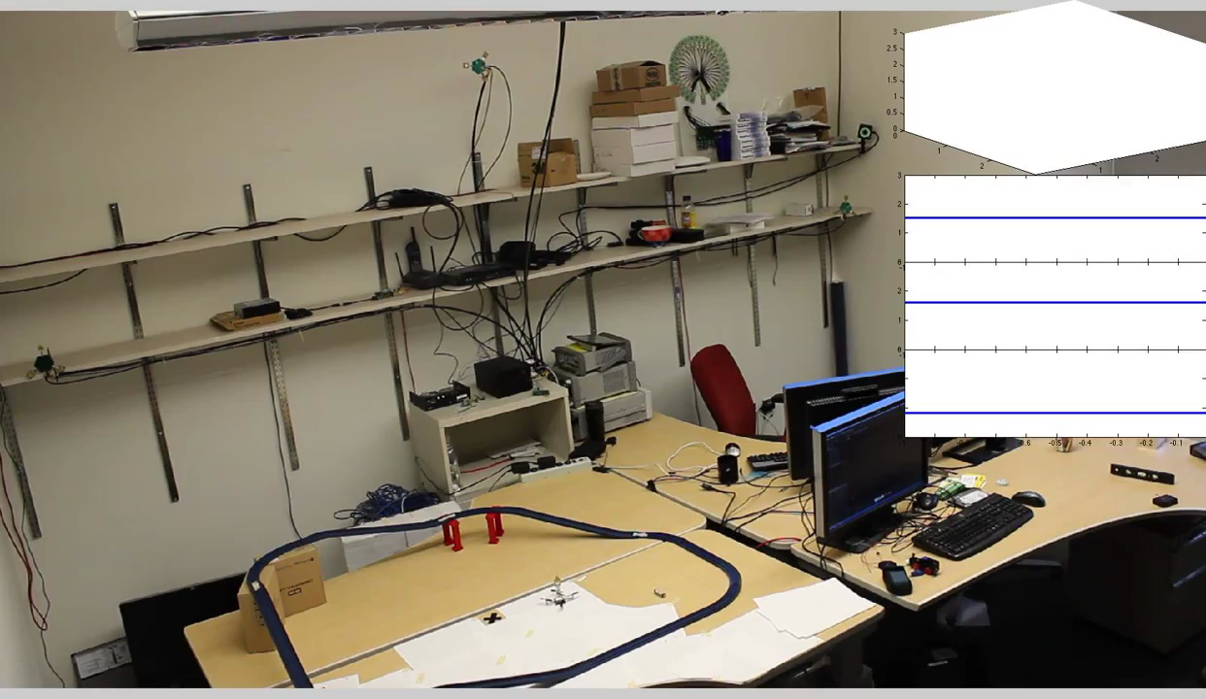
Harmonium: Enabling high-speed, high-fidelity tracking of fast-moving objects with UWB
Tag weighs 3g and costs ~$4.50
Draws 75mW transmitting, 3.9mJ / fix
14cm median 31cm 90%ile
Key tradeoff is asymmetry
Harmonia: Wideband Spreading for Accurate Indoor RF Localization (HotWireless’14)
Harmonium: Asymmetric, Active UWB for High-Quality Indoor Localization (To Appear: IPSN’16)
Benjamin Kempke, Pat Pannuto, and Prabal Dutta

Slide 9
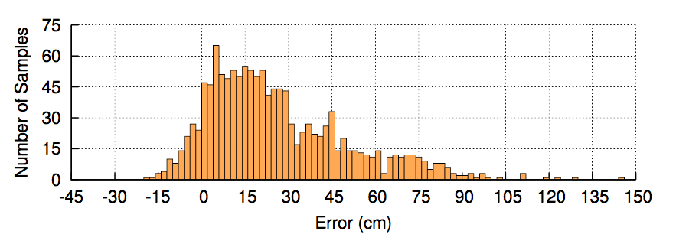
PolyPoint is a low-cost, high-fidelity indoor localization system
A high-accuracy, stateless RF localization system
Fixed, known-location anchors
Tags range to each anchor
Key to accuracy is diversity
Frequency
Spatial
Polarization
2015 Microsoft Indoor Localization Competition
Best-in-class 2D median accuracy (9cm)
3rd Place 2D average accuracy (60cm)
PolyPoint: Guiding Indoor Quadrotors with Ultra-Wideband Localization (HotWireless’15)
Benjamin Kempke, Pat Pannuto, and Prabal Dutta

Slide 10
PolyPoint Today: Providing localization as a drop-in, modular primitive
TriPoint
Drop-in localization module
Towards “where-am-I” as an I²C command
TriTag
Carrier board
Adds BLE for offloading position information
Demo – PolyPoint: High-Precision Indoor Localization with UWB (SenSys’15)
Benjamin Kempke, Pat Pannuto, Bradford Campbell, Joshua Adkins, and Prabal Dutta

Slide 11
Looking 20 years into the future
Today’s digital things have a few fundamental primitives
“Sense of Self”
“Sense of Time”
Tomorrow’s things will include a “Sense of where”
The long tail is full of interesting research
There are devices for whom a sense of time is difficult today
There will be those for whom location is difficult tomorrow
Drives a lot of unique an novel systems and technology solutions

Slide 12
For More Information…
http://lab11.eecs.umich.edu
http://github.com/lab11
lab11/vlc-localization [luxapose]
lab11/opo
lab11/fast-square [harmonium]
lab11/polypoint
http://patpannuto.com

